Slide 1



Recap: what is a computer?
What do computers do?
Where do we find them?
Is a phone a computer?
A game console?
What else do you think has a computer inside?
Notes:
Computers are not just laptops and desktops PCs, they all around us, inside phones, games consoles, TVs and even cars.

Slide 2
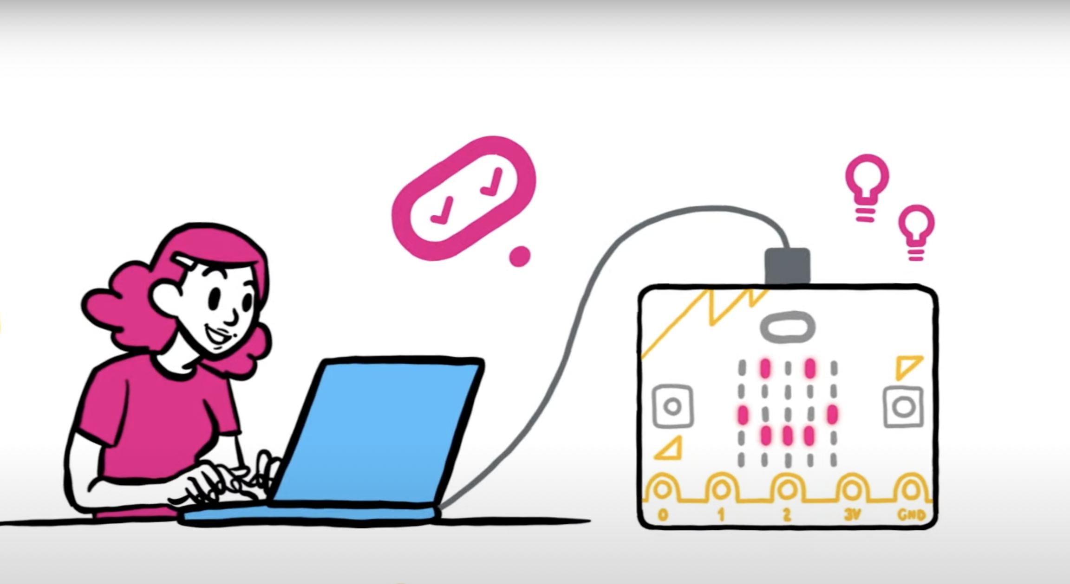

Think: what is a micro:bit?
A tiny computer
You tell it what to do by writing instructions in code
The code is an algorithm, a sequence of instructions.
The micro:bit can show words on its LED display output.
You can unplug your micro:bit, attach a battery pack and the code still works
Notes:
LEDs are light emitting diodes, the lights on the front of the micro:bit.
Information coming out of a computer is called an output.

Slide 3




Think: introduction to the BBC micro:bit
Optionally play video: https://youtu.be/u2u7UJSRuko

Slide 4





Think: learning objectives
I can explain that the micro:bit is a tiny computer.
I can explain that computers need to be given sets of instructions (an algorithm) in code.
I can give the micro:bit instructions in code to make a name badge using the LED display output.
Notes:
Today we’re going to code our micro:bits to show our names. Our names are shown scrolling across the LED lights on the front of the micro:bit. We’ll create an algorithm – instructions in code, a language the micro:bit can understand.

Slide 5
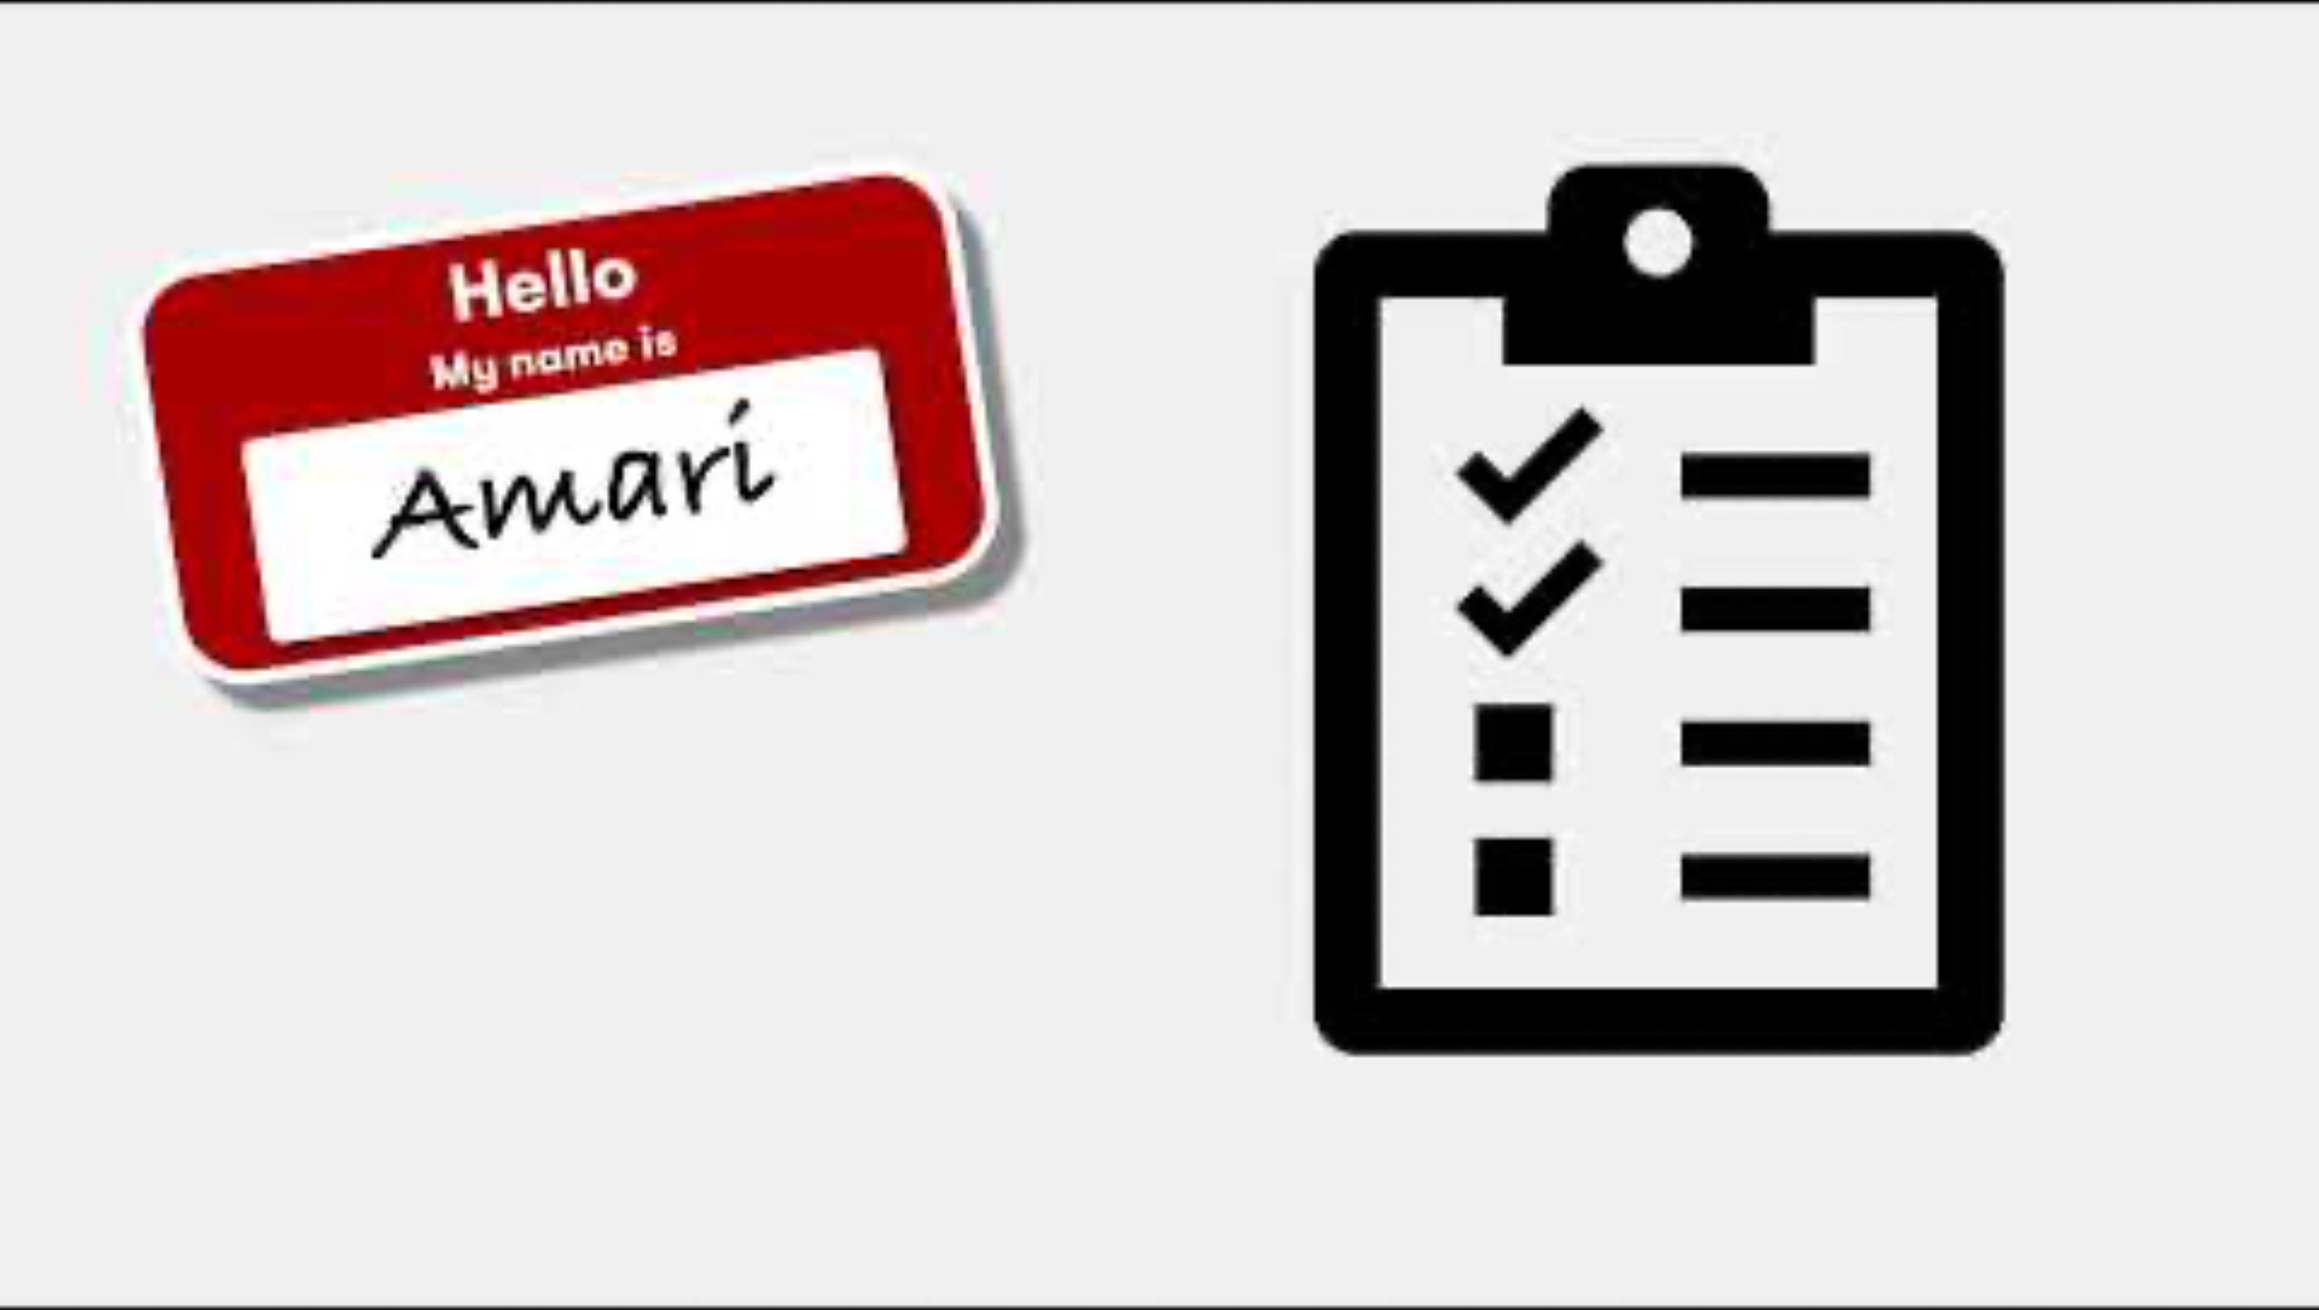
Think: name badge introduction video
Optionally play video: https://youtu.be/teC0wzWF4tI

Slide 6
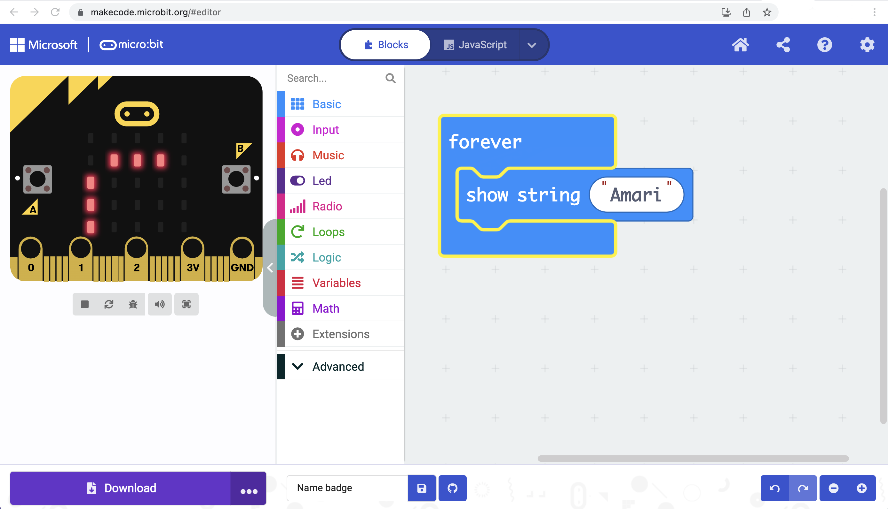
Introducing the MakeCode editor
1
Toolbox: find code blocks
Workspace: assemble your code
Simulator: test your code
Download code to your micro:bit
2
2
3
3
1
4
4
Notes:
If it’s your first lesson with the micro:bit, introduce the parts of the MakeCode editor. The MakeCode block editor works a lot like Scratch.

Slide 7


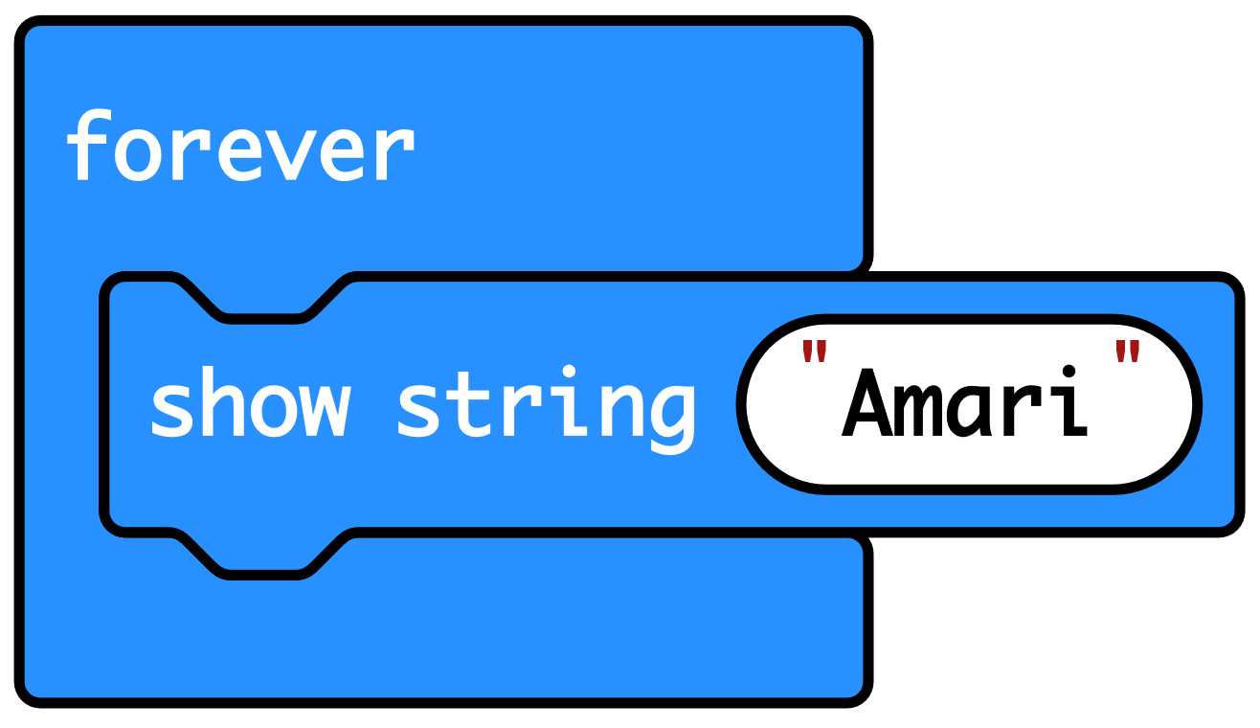

Create: examine the code
‘Forever’ is a loop that keeps the code running.
‘Show string’ scrolls the string of letters that make up your name across the LED display output.
The code then goes back to the top of the loop and runs again.
Teacher: open completed code in editor
Notes:
You can follow the link to open the completed code in the editor.
Model changing the name in the ‘show string’ block and seeing it change in the simulator.

Slide 8

Create: build the code
Open a new MakeCode project https://makecode.microbit.org/
Notes:
You can follow the link to open a new MakeCode project and model building the code yourself – or use slide 10 to show a YouTube coding video, or slide 11 to show an animated GIF of building the code if YouTube is blocked in your school.

Slide 9

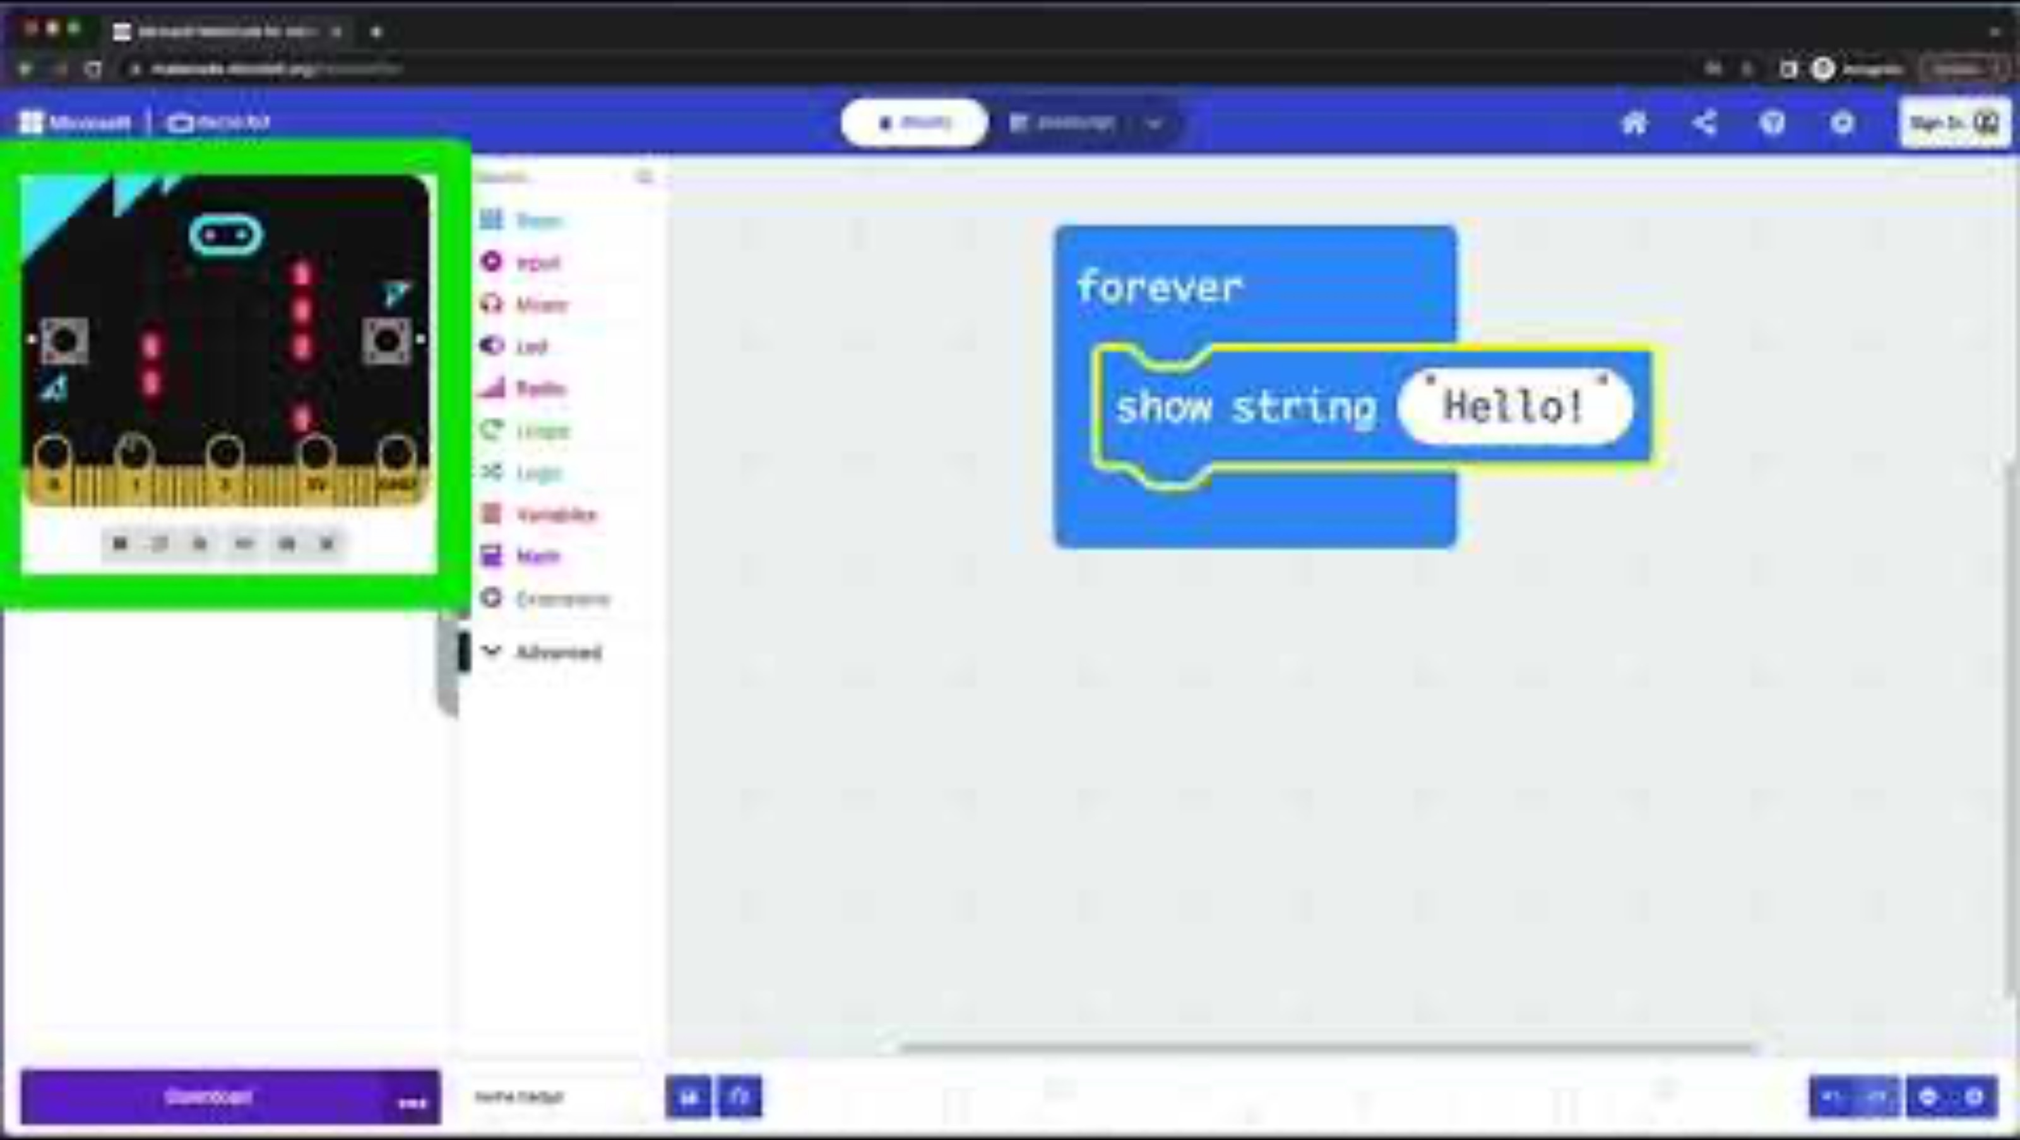
Create: coding video
YouTube coding video: https://mbit.io/lessons-name-code-video
Notes:
Optionally share this YouTube coding video with your students: https://mbit.io/lessons-name-code-video

Slide 10


Create: coding animation
Notes:
Animated GIF of building the code you can share with your students, if YouTube is blocked in your school.

Slide 11
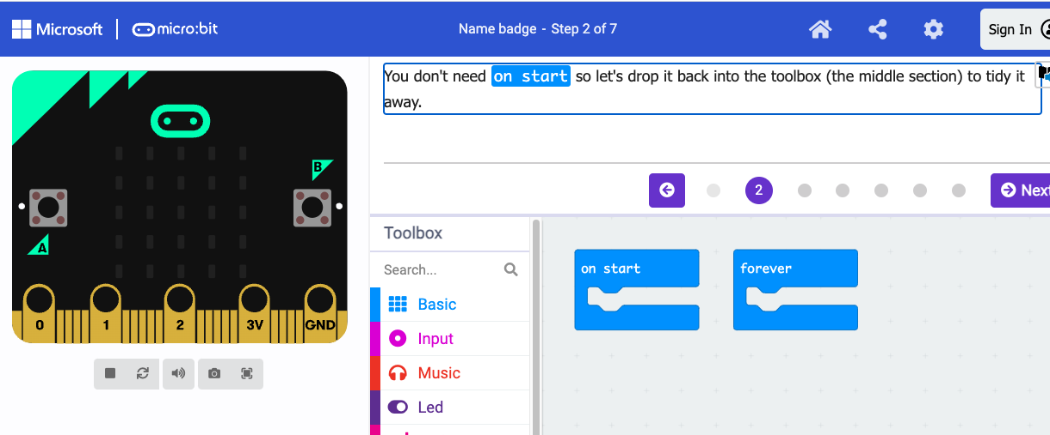
Create: step-by-step online tutorial
https://mbit.io/tutorial-name-badge
Notes:
You can optionally share this online step-by-step tutorial with your students to follow individually.

Slide 12


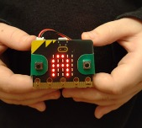

Evaluate
Download your code to a micro:bit
Does it work as you expect?
How good is the project?
Could it have other uses?
How does it work?
Notes:
Students transfer code to their micro:bit and test.
If you have a battery packs, encourage students to unplug micro:bits from computers and attach batteries. Their code remains on the micro:bit and will still work
Does it work as you expect?
If not, do you need to debug the code and download it again?
How good is the project?
Can you think of anyone who would like this project and find it useful of enjoyable?
How could you improve it?
Could it have other uses?
How does it work?
Encourage students to think about how it works when holding it in their hands.

Slide 13

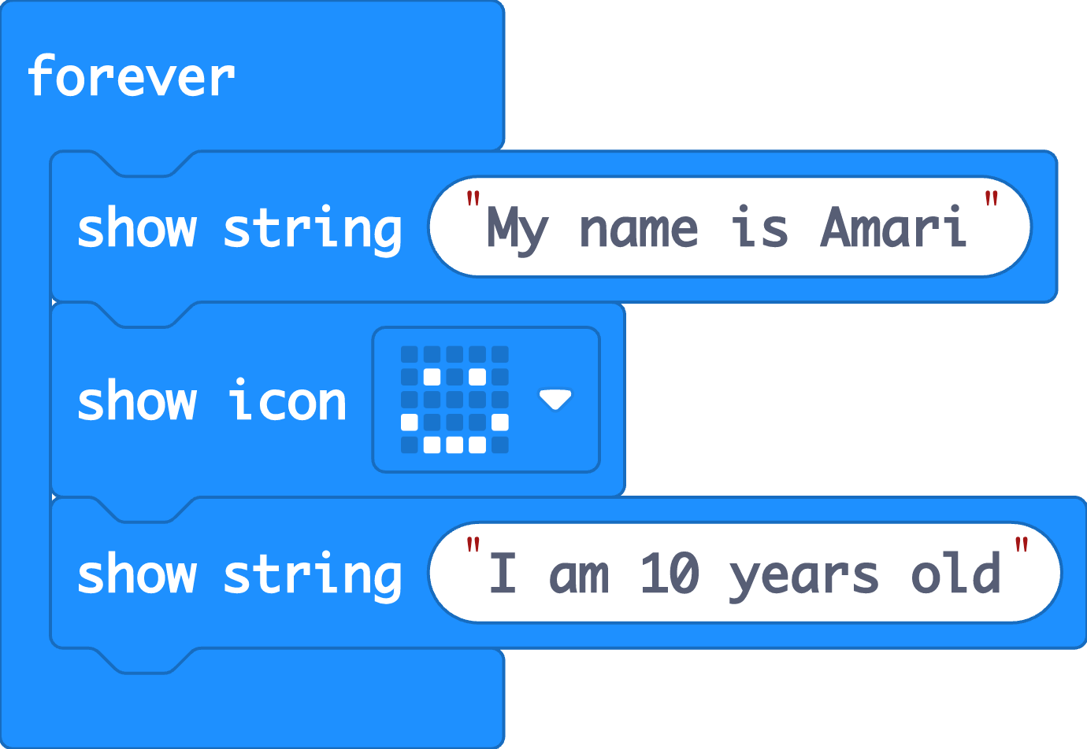


Extend
Add more words or numbers to express more about yourself.
Add some icons (pictures) using the ‘show icon’ block to show how you’re feeling or express your personality.
Notes:
If students finish early, they can remix their code to explore different uses of the LED display output.

Slide 14

Share: revisit the learning objectives
I can explain that that the micro:bit is a tiny computer.
I can explain that computers need to be given sets of instructions (an algorithm) in code.
I can give the micro:bit instructions in code to make a name badge using the LED display output.
Notes:
Ask:
How did you tell your micro:bit what to do? (e.g. used MakeCode blocks to make an algorithm or instructions in code that the micro:bit can understand)
What code did you use? (‘forever’ loops, ‘show string’, possibly ‘show icon’ blocks)
What parts of the micro:bit did you use? (LED display output)
Did you change the code? (I used my own name, I added more words and pictures to say more about myself.)

Slide 15



Next steps
Today we used the ‘forever’ loop block and instructions to make name badges.
Next time we’ll use the ‘forever’ loop block and sequences of instructions to make animations.

